Slide 1
Substance Abuse Prevention and Control
Prevention System of Services
Prevention Services
Yolanda Cordero, MPA
Chief, Prevention Services,
Substance Abuse Prevention & Control
Notes:
SAPC Prevention Services is comprised of a network of 31 contracted community-based organizations implementing evidence-based community and individual-level services to address SAPC’s Goals and Objectives.
Strategic Plan Goals –
Objectives -

Slide 2
Prevention Frameworks
Strategic Prevention Framework (SPF)
Institute of Medicine (IOM) classification
SAMHSA’s Center for Substance Abuse Prevention (CSAP) Strategies.
The use of these frameworks are required by the State Department of Health Care Services and included as part of their data reporting requirements.

Slide 3
Prevention Strategies
Education
Community Based Process
Information Dissemination
Alternative Activities
Environmental
Problem Identification and Referral
Notes:
SAMHSA Center for Substance Abuse Prevention (CSAP)

Slide 4
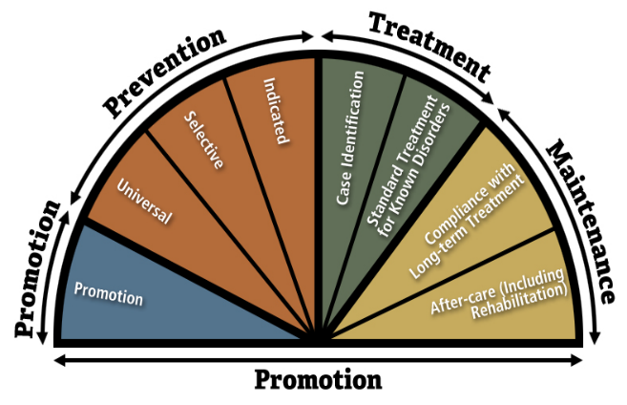
INSTITUTE OF MEDICINE (iom)
Prevention Classification
Notes:
Universal prevention targets the entire population (local community, school, and/or neighborhood) with messages and programs aimed at preventing or delaying the (ab)use of AOD.
Selective prevention targets subsets of the total population at risk for substance abuse by virtue of their membership in a particular population segment.
Indicated prevention is designed to prevent the onset of substance abuse in individuals who do not meet Diagnostic and Statistical Manual of Mental Disorders.

Slide 5
Goal 1: Reduce misuse of Rx and OTC Medications
Goal 3: Decrease underage drinking and binge drinking among youth and young adults
Strategic Plan
Goals
Goal 2: Decrease marijuana use among youth and young adults.
Goal 4: Prevent meth and other illicit drug use by youth and young adults
Notes:
Safe Med LA – Community Education Action Team
RAM – Provider Coalition and SPA-Based Coalitions

Slide 6
Contributing Community
Risk Factors
Availability
Accessibility
Social Norms
Built Environment
Social Determinants of Health

Slide 7
Prevention Program Efforts
Rethinking Access to Marijuana Coalition
Marijuana Media Campaign
DPH-SAPC Cannabis Summit
Emerging Leaders Youth Summit
Marijuana Education Initiative (MEI) Pilot
Community Needs Assessment (CNA) Surveys
Cannabis Education, Prevention and Intervention (EPI) Workgroup
Marijuana Public Smoking Initiative (MPSI)
Community Health Environmental Scan (CHES)
Notes:
1. 2014 formed the RAM Coalition – Town Hall Meeting, Focus Groups, Fact Sheets, Presentation – MRT Website Expansion (grassroots)
2. 2017 Marijuana Campaign RFSQ Frazer Communications, launched May 2018. Videos and other materials on SAPC’s website
3. Cannabis Summit – January 2018
4. Emerging Leaders Youth Summit – April 7th 2018
5. MEI – 2017
6. CNA, 9500 surveys collected - Domains: 1. Risk Perception, 2. Perception of access/availability 3. attitudes toward use, 4. Patterns of use, 5. Motivation for use, 6. Consequences of use - October 2017
7. EPI – BOS Motion on February 2017
8. MPSI – 2018
9. CHES - 2018

Slide 8
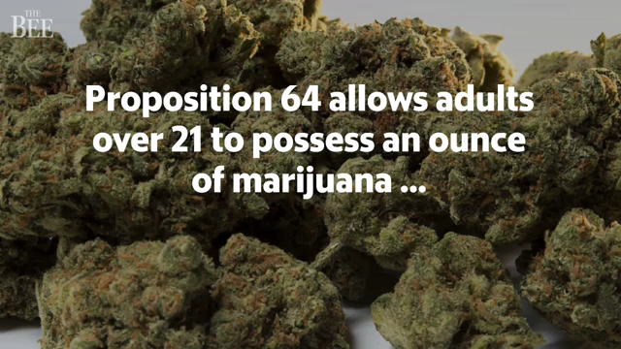

Slide 9
LAC Youth, Marijuana Use and Perceptions
2017,among LAC youth ages 12-17:
1 in 10 used in the last month¹
Mean age of initiating marijuana use was 13¹
Over half of youth perceived easy access to get marijuana on the street.¹
1 in 3 perceived occasional use of marijuana was harmful¹
Among youth who used marijuana, approximately half have gone to school under the influence of marijuana¹
Notes:
1 LOS ANGELES COUNTY DEPARTMENT OF PUBLIC HEALTH, SUBSTANCE ABUSE PREVENTION AND CONTROL:
COMMUNITY NEEDS ASSESSMENT SURVEY, 2017, CONTACT TKIM@PH.LACOUNTY.GOV.

Slide 10
2015, Among LAC High School Youth:
1 in 3 youth reported ever trying marijuana²
17% males and 16% females used marijuana once or more in the last 30 days²
More men initiated used before they turned 13²
About 1 in 10 tried marijuana before they turned 13²
Notes:
CNA
2 YOUTH RISK BEHAVIORAL SURVEILLANCE SYSTEM. CDC YOUTH ONLINE. AVAILABLE AT HTTPS://NCCD.CDC.GOV/YOUTHONLINE/APP/RESULTS.ASPX?LID=LO

Slide 11
Access and Availability
62% of survey responders felt that it was easy for them to get marijuana on the streets around their neighborhoods
Slightly over half of youth, ages 12-17, felt they had easy access to marijuana
Over 70% of young adults between 18-20 reported having easy access to marijuana
Notes:
CNA – Need to confirm the number of youth surveys for this data and number of adults
Survey Domains:
Risk Perception
Perception of access/availability
Attitudes toward use
Patterns of use
Motivation for use
Consequences of use
62% of survey responders felt that it was easy for them to get marijuana on the streets around their neighborhoods
Slightly over half of youth, ages 12-17, felt they had easy access to marijuana
Over 70% of young adults between 18-20 reported having easy access to marijuana
48% of all responders reported having used marijuana at least once in their lifetime. Among those who reported lifetime use of marijuana, 29% reported current use of marijuana.
Among youth, 26% and among young adults 53% reported using marijuana at least once in their lifetime.

Slide 12
2004 to 2016, among LAC residents ages
12 and over:
Fewer people perceived smoking marijuana once a month as harmful (decreased from 40% in 2006-2008 to 29% in 2012-2014)³
Current use increased from 6% in 2006-08 to 8% in 2012-14.³
Notes:
3 - NATIONAL SURVEY ON DRUG USE AND HEALTH (NSDUH). AVAILABLE AT HTTPS://WWW.SAMHSA.GOV/DATA/POPULATION-DATA-NSDUH/REPORTS?TAB=38 AND HTTPS://ARCHIVE.SAMHSA.GOV/DATA/NSDUH.ASPX

Slide 13
2005 to 2015, among Los Angeles
residents ages 0 through 17:
Emergency Department visits related to marijuana poisoning, dependence, and abuse has increased 4-fold among both men and women and even greater among African Americans and Latinos.⁴
1 - LOS ANGELES COUNTY DEPARTMENT OF PUBLIC HEALTH, SUBSTANCE ABUSE PREVENTION AND CONTROL: COMMUNITY NEEDS ASSESSMENT SURVEY, 2017, CONTACT TKIM@PH.LACOUNTY.GOV.
2 - YOUTH RISK BEHAVIORAL SURVEILLANCE SYSTEM. CDC YOUTH ONLINE. AVAILABLE AT HTTPS://NCCD.CDC.GOV/YOUTHONLINE/APP/RESULTS.ASPX?LID=LO
3 - NATIONAL SURVEY ON DRUG USE AND HEALTH (NSDUH). AVAILABLE AT HTTPS://WWW.SAMHSA.GOV/DATA/POPULATION-DATA-NSDUH/REPORTS?TAB=38 AND HTTPS://ARCHIVE.SAMHSA.GOV/DATA/NSDUH.ASPX
4 - OFFICE OF STATEWIDE HEALTH PLANNING AND DEVELOPMENT (OSHPD). EMERGENCY DEPARTMENT AND INPATIENT DISCHARGE DATA SETS 2006-2015. CALIFORNIA DEPARTMENT OF PUBLIC HEALTH.
Notes:
4 - OFFICE OF STATEWIDE HEALTH PLANNING AND DEVELOPMENT (OSHPD). EMERGENCY DEPARTMENT AND INPATIENT DISCHARGE DATA SETS 2006-2015. CALIFORNIA DEPARTMENT OF PUBLIC HEALTH.

Slide 14
Perception of Harm
59% of survey responders felt there was no harm associated with marijuana use;
16% believed there was harm if driving under the influence.
13% of responders felt cannabis use would decrease motivation!
12% were concerned about illegal activities! 11% felt it would lead to poor work performance.

Slide 15
Cannabis Use Consequences
27% of all survey reported having gone to work or school under the influence of marijuana!
Almost half (49%) of Youth, ages 12-17, and 31% of young adults ages 18-20 reported having gone to school under the influence
Notes:
CNA

Slide 16


Marijuana and the Teen Brain
What We Now Know
Adolescence is a critical period in brain development.
The brain is still developing until approximately age 25
Notes:
Different parts of the brain are responsible for coordinating and performing specific functions.
Drugs can alter important brain areas that are necessary for life-sustaining functions and can drive the compulsive drug abuse that marks addiction.
Adolescence is a time of critical brain development, especially in the parts of the brain needed for complex tasks, organization, planning and judgment.
The teen years are a time of tremendous opportunity and risk for the brain
The endocannabinoid system is important for maintaining brain health and proper development, and THC interferes with its proper functioning!
Regular marijuana use in adolescence may have lasting effects on memory and IQ
Source: NIH

Slide 17
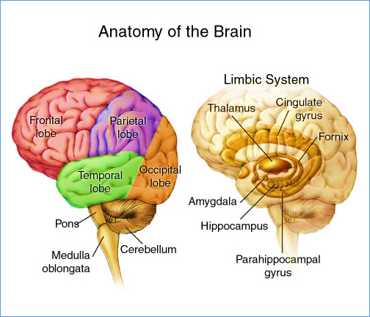
ADOLESCENT BRAIN DEVELOPMENT
The Prefrontal Cortex is responsible for controlling planning, working memory, organization, modulating mood, and is constantly changing and growing.
The Limbic System is responsible for controlling emotion and other brain functions related to our instincts and memories, such as giving a sense of reward for engaging in risk.
Notes:
One of the periods of rapid growth for the human brain is ages 12 to 25.
This is a crucial period that determines the structure and future functioning of the adult brain.
The Prefrontal Cortex (CEO of the Brain) is responsible for controlling planning, working memory, organization, and modulating mood constantly changing and growing.
The Limbic System gives a sense of reward for engaging in risk.
Why youth are more likely to take risks. Limbic System or the “Wow Factor”
Adolescents tend to use an alternative part of the brain– the AMYGDALA (emotions) rather than the prefrontal cortex (reasoning) to process information
To appreciate consequences of risky behavior, one has to have the ability to think through potential outcomes and understand the permanence of consequences, due to an immature prefrontal cortex, teens are not skilled at doing this
Teens do not take information, organize it, and understand it in the same way that adults do—they have to learn how to do this
Source:
Meier, M. H., Caspi, A., Ambler, A., Harrington, H., Houts, R., Keefe, R. S. E., … Moffitt, T. E. (2012). Persistent cannabis users show neuro psychological decline from childhood to midlife. Proceedings of the National Academy of Sciences, 109(40), E2657–E2664. http:// doi.org/10.1073/pnas.1206820109

Slide 18
ADOLESCENT BRAIN DEVELOPMENT
Underdevelopment of the frontal lobe/prefrontal cortex make adolescents more prone to “behave emotionally or with ‘gut’ reactions”
Adolescents tend to use an alternative part of the brain– the AMYGDALA (emotions) rather than the prefrontal cortex (reasoning) to process information.
Notes:
The parts of the adolescent brain which develop first are those that control physical coordination, emotion and motivation.
The part of the brain which controls reasoning and impulses — known as the prefrontal cortex. This part of the brain does not fully mature until the age of 25.
To appreciate consequences of risky behavior, one has to have the ability to think through potential outcomes and understand the permanence of consequences, due to an immature prefrontal cortex, teens are not skilled at doing this
Teens do not take information, organize it, and understand it in the same way that adults do—they have to learn how to do this

Slide 19
Cannabis and the Adolescent Brain
The National Institute on Drug Abuse Blog Team. (2014, December 1). Marijuana Use Can Lower Your Grades. Retrieved from https://teens.drugabuse.gov/blog/post/marijuana-use-can-lower-your-grades on March 19, 2018.

Slide 20
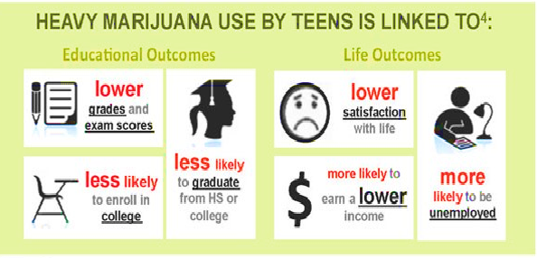
Notes:
National Institute on Drug Abuse

Slide 21
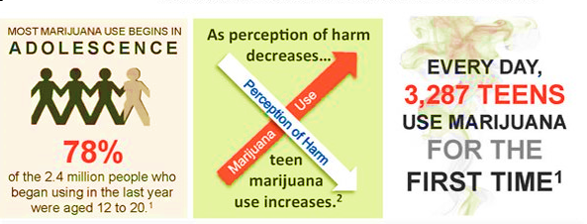
Notes:
Why does it matter?
So as use of marijuana increases… more youth will be at risk of marijuana use and later addiction…
Use of marijuana during adolescence makes permanent changes on the brain that are not reversible.
Source: NIDA: Marijuana https://d14rmgtrwzf5a.cloudfront.net/sites/default/files/1380-marijuana.pdf

Slide 22
Resources
LAC Substance Use Treatment Services
Screening and Referral Call 1-844-804-7500
DPH – Substance Abuse Prevention and Control, Prevention Services:
Prevention Website http://publichealth.lacounty.gov/sapc/prevention/PreventionLinks.htm
DPH Prop 64 Resource Webpage:
http://publichealth.lacounty.gov/sapc/Prop64/Proposition64.htm
LA County Office of Cannabis Management: https://www.lacounty.gov/marijuana

